Slide 1
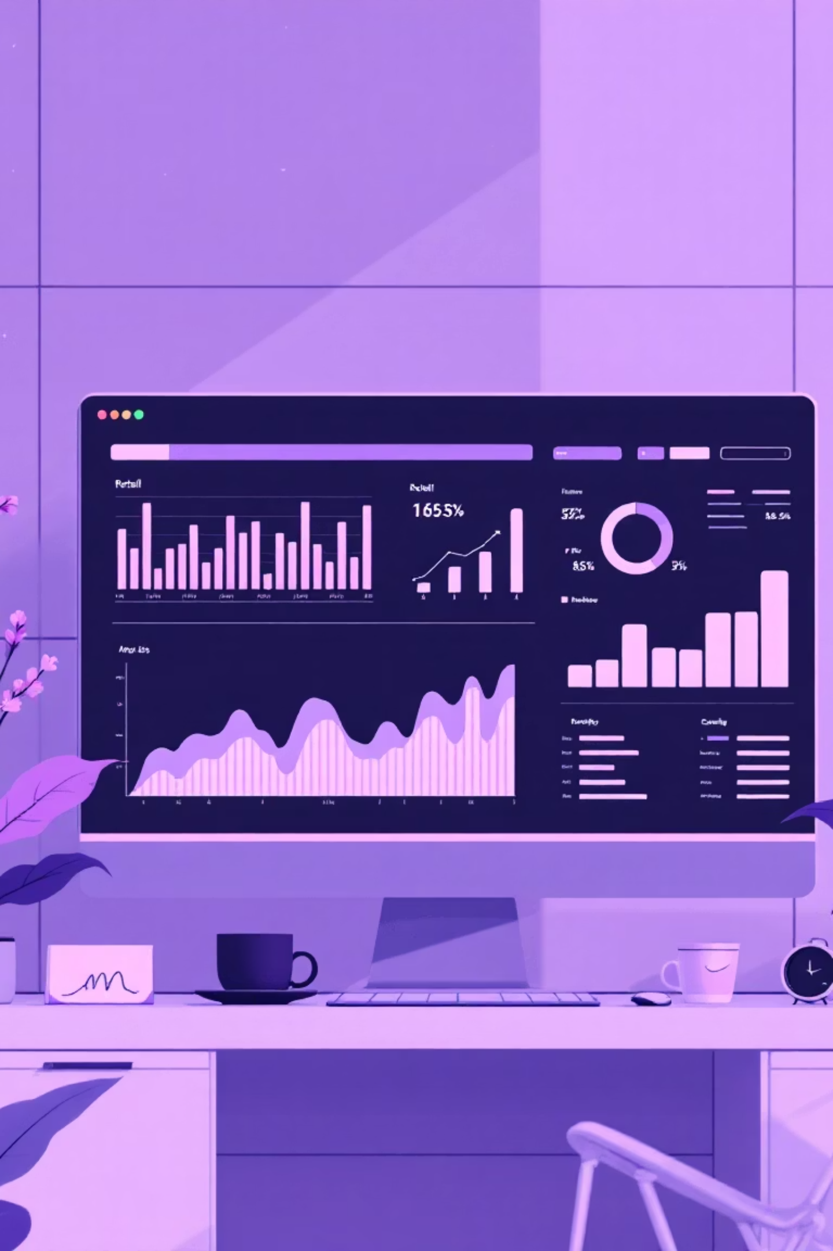
Customer Shopping Behavior Analysis
Analyzing 3,900 purchases to uncover insights into spending patterns, customer segments, and product preferences that drive strategic business decisions.

Slide 2
Dataset Overview
3,900
18
37
Total Purchases
Data Features
Missing Values
Transactions analyzed across various product categories
Comprehensive attributes covering demographics and behavior
Only in Review Rating column, handled through imputation
Customer Demographics
Purchase Details
Shopping Behavior
Age, Gender, Location
Item, Category, Amount
Discounts & Promo Codes
Subscription Status
Season, Size, Color
Purchase Frequency & Reviews

Slide 3

Data Preparation in Python
01
Data Loading & Exploration
Imported dataset using pandas, examined structure with df.info() and summary statistics
02
Missing Data Handling
Imputed 37 missing Review Rating values using median rating per product category
03
Feature Engineering
Created age_group bins and purchase_frequency_days columns for deeper analysis
04
Database Integration
Connected to PostgreSQL and loaded cleaned DataFrame for SQL analysis

Slide 4

Revenue Analysis by Gender
Key Finding
SQL analysis revealed distinct revenue patterns between male and female customers, providing insights for targeted marketing strategies.
Understanding gender-based purchasing behavior helps optimize product positioning and promotional campaigns.

Slide 5

Customer Spending Insights
High-Spending Discount Users
Top 5 Products by Rating
Identified customers who used discounts but still spent above average purchase amount
Found products with highest average review ratings to guide inventory and marketing
Shipping Type Comparison
Compared average purchase amounts between Standard and Express shipping options

Slide 6

Subscription Impact
Subscribers vs. Non-Subscribers
Compared average spend and total revenue across subscription status, revealing significant differences in customer lifetime value.
Subscribers demonstrate higher engagement and spending patterns, making them valuable for long-term growth.

Slide 7
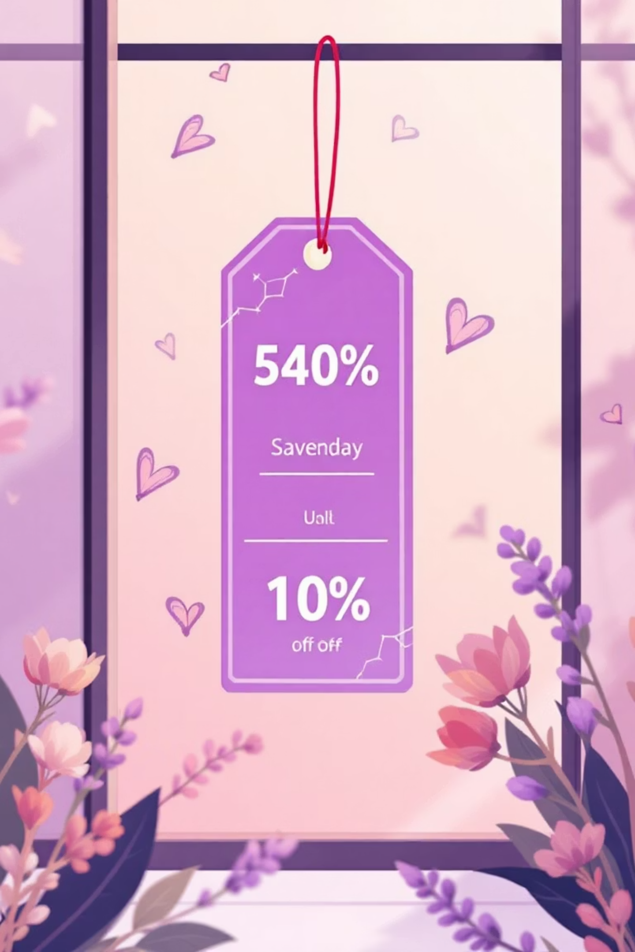



Product & Discount Analysis
Discount-Dependent Products
Identified 5 products with highest percentage of discounted purchases
Top 3 per Category
Listed most purchased products within each category for inventory optimization
Pricing Strategy
Insights guide balanced approach between sales volume and profit margins

Slide 8




Customer Segmentation
Returning Customers
Repeat buyers showing interest and potential for loyalty programs
New Customers
First-time buyers requiring onboarding and engagement strategies
Loyal Customers
High-frequency purchasers (>5 purchases) more likely to subscribe
Customers with more than 5 purchases show significantly higher subscription rates, indicating strong correlation between repeat behavior and loyalty.

Slide 9

Interactive Power BI Dashboard
Visual Insights
Real-Time Analysis
Interactive dashboard presents key metrics including revenue by age group, product performance, and customer behavior patterns.
Enables stakeholders to explore data dynamically and make informed decisions based on current trends.

Slide 10
Strategic Recommendations
1
2
3
Boost Subscriptions
Customer Loyalty Programs
Review Discount Policy
Promote exclusive benefits for subscribers to increase recurring revenue
Balance sales boosts with margin control for sustainable growth
Reward repeat buyers to move them into the "Loyal" segment
4
5
Product Positioning
Targeted Marketing
Highlight top-rated and best-selling products in marketing campaigns
Focus efforts on high-revenue age groups and express-shipping users

